Slide 1
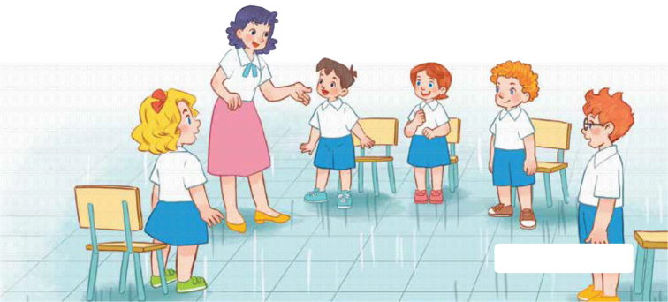
7
Classroom instructions
LESSON 1 – PERIOD 1

Slide 2
CONTENTS
Look, listen and repeat.
Let’s talk.
Listen, point and say.
Fun corner and wrap-up
Warm-up and review

Slide 3
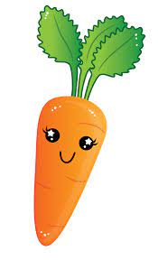
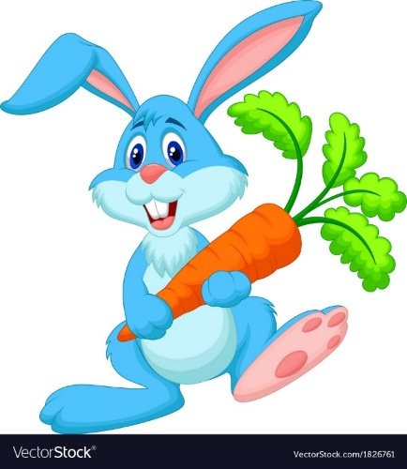
Warm-up and review
Notes:
- Divide the class into 2 teams. Each team chooses one carrot to go to the question.
- Have pupils listen and choose the right answer.
- Back to the menu for another question.
- Pupils take turns to play the game until there are no carrots left.
- The team who gets the most carrots is the winner.

Slide 4
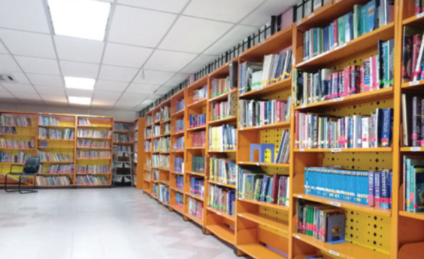
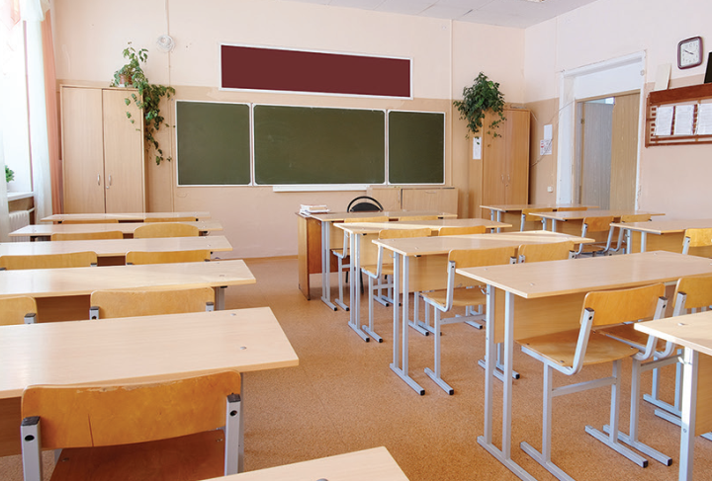
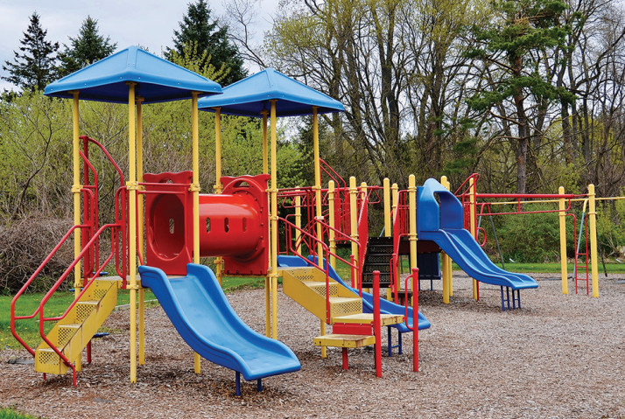
Listen and choose.
library
classroom
playground
Back
Notes:
- Click “Listen and choose” to play the audio.
- Teacher can click each answer to check.
- Click the “Back” button on the bottom right to go back to the game.

Slide 5
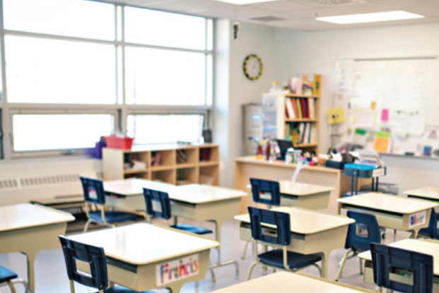
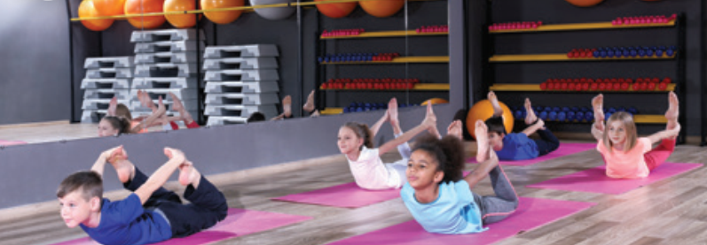
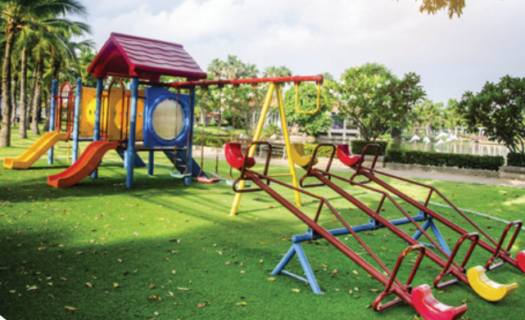
Listen and choose.
classroom
gym
playground
Back
Notes:
- Click “Listen and choose” to play the audio.
- Teacher can click each answer to check.
- Click the “Back” button on the bottom right to go back to the game.

Slide 6
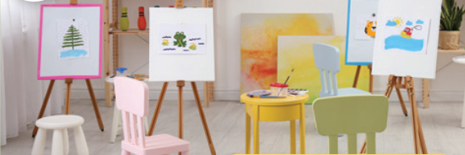
Listen and choose.
Let’s go to the _____.
OK, let’s go.
computer room
gym
art room
Back
Notes:
- Click “Listen and choose” to play the audio.
- Teacher can click each answer to check.
- Click the “Back” button on the bottom right to go back to the game.

Slide 7
Listen and choose.
Let’s go to the _____.
OK, let’s go.
computer room
art room
music room
Back
Notes:
- Click “Listen and choose” to play the audio.
- Teacher can click each answer to check.
- Click the “Back” button on the bottom right to go back to the game.

Slide 8
Listen and choose.
Let’s go to the _____.
OK, let’s go.
music room
gym
art room
Back
Notes:
- Click “Listen and choose” to play the audio.
- Teacher can click each answer to check.
- Click the “Back” button on the bottom right to go back to the game.

Slide 9
Listen and choose.
Let’s go to the _____.
OK, let’s go.
music room
computer room
art room
Back
Notes:
- Click “Listen and choose” to play the audio.
- Teacher can click each answer to check.
- Click the “Back” button on the bottom right to go back to the game.

Slide 10
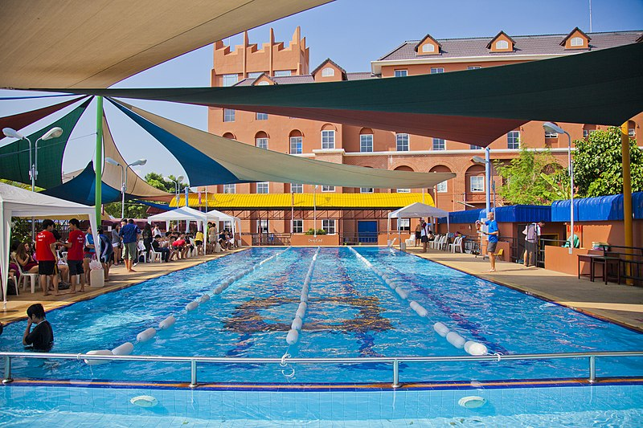
Is this our swimming pool?
Yes, it is./ No, it isn’t.
No, it isn’t.
Yes, it is.
Back
Notes:
- Teacher asks the question then show the picture. - Ask the students if the picture is correct.

Slide 11
Is this our classroom?
Yes, it is./ No, it isn’t.
Yes, it is.
No, it isn’t.
Back
Notes:
- Teacher asks the question then show the picture. - Ask the students if the picture is correct.

Slide 12
Is this our library?
Yes, it is./ No, it isn’t.
No, it isn’t.
Yes, it is.
Back
Notes:
- Teacher asks the question then show the picture. - Ask the students if the picture is correct.

Slide 13
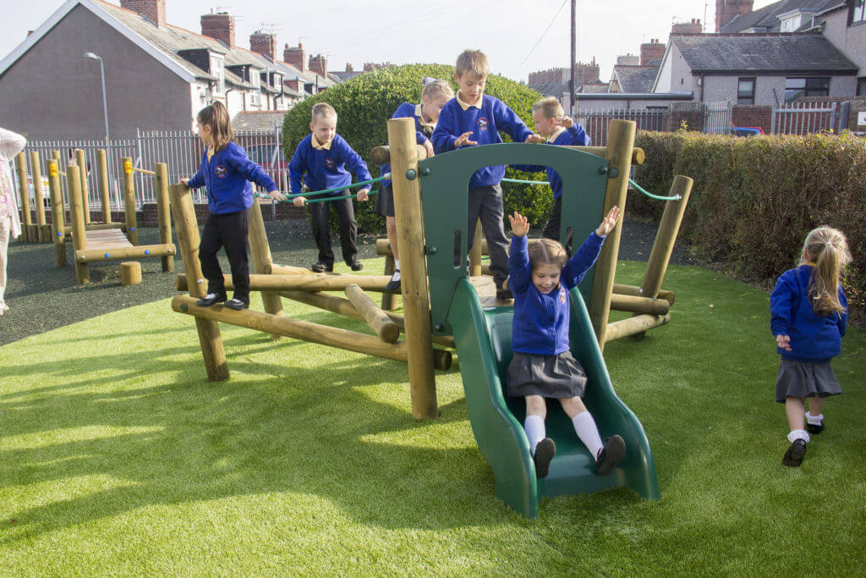
Is this our playground?
Yes, it is./ No, it isn’t.
No, it isn’t.
Yes, it is.
Back
Notes:
- Teacher asks the question then show the picture. - Ask the students if the picture is correct.

Slide 14
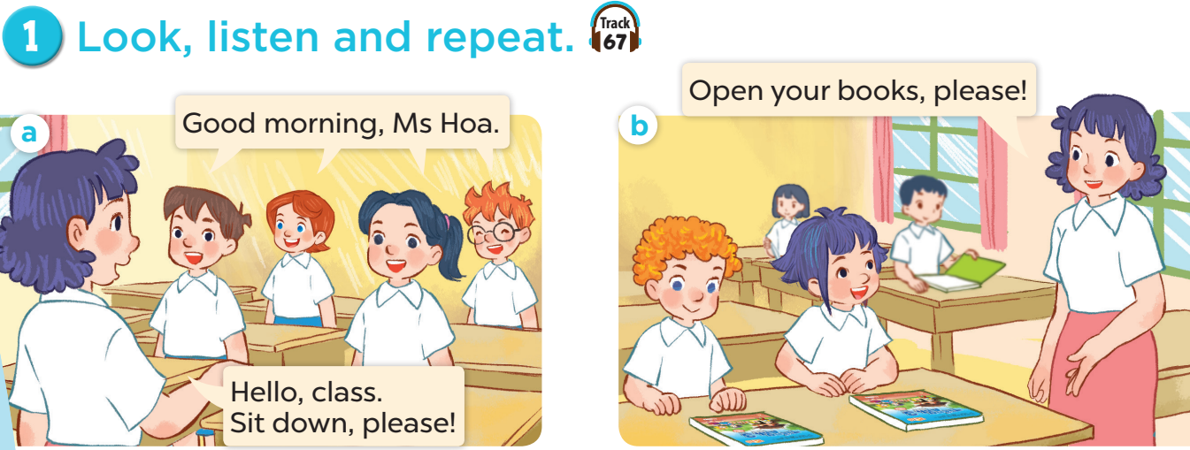

Slide 16
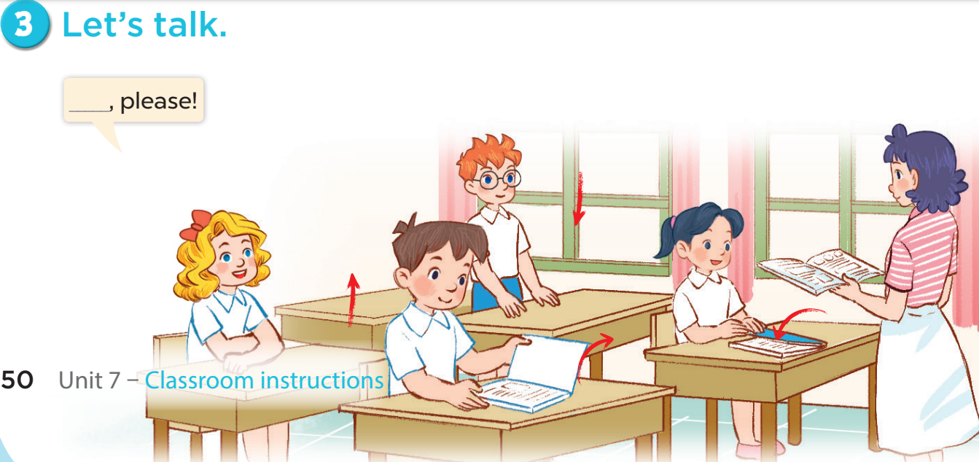

Slide 17
Fun corner and wrap-up

Slide 18
A
B
60
10
70
45
90
30
20
100
35
80
40
50
Notes:
- Divide the class into 2 teams.
- Each team chooses one umbrella to go to the question.
- Have pupils unscramble the sentences.
- Back to the menu for Wheel of Fortune.
- The pupils can spin the wheel to get points if they answer correctly.
- The team who gets more points is the winner.

Slide 19
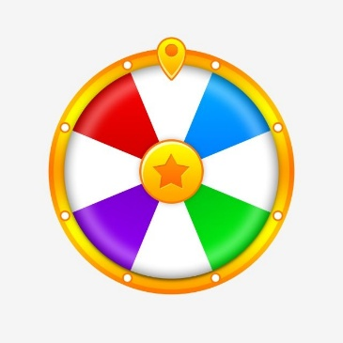
your
book,
please!
Open your book, please!
Open
CHECK
Notes:
- Click “CHECK” to check the answer. - Click the wheel on the bottom right to go back to the wheel.

Slide 20
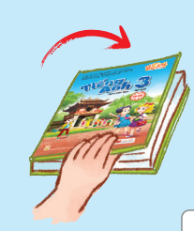
please!
your
book,
Close
Close your book, please!
CHECK
Notes:
- Click “CHECK” to check the answer. - Click the wheel on the bottom right to go back to the wheel.

Slide 21
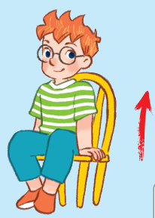
Stand up, please!
Stand
please!
up,
CHECK
Notes:
- Click “CHECK” to check the answer. - Click the wheel on the bottom right to go back to the wheel.

Slide 22
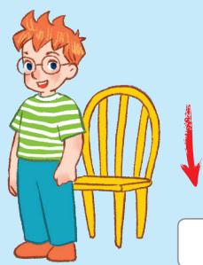
Sit down, please!
Sit
down
please!
CHECK
Notes:
- Click “CHECK” to check the answer. - Click the wheel on the bottom right to go back to the wheel.

Slide 23
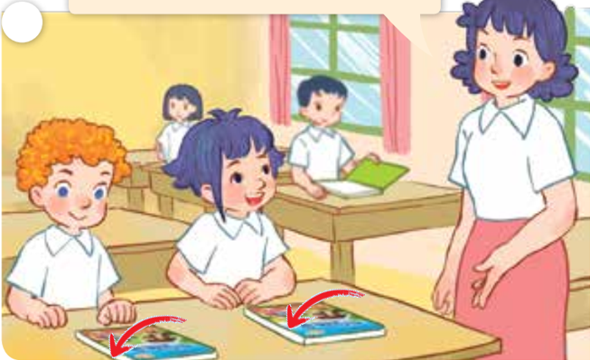
please!
Close your books, please!
Close
your
books,
CHECK
Notes:
- Click “CHECK” to check the answer. - Click the wheel on the bottom right to go back to the wheel.

Slide 24
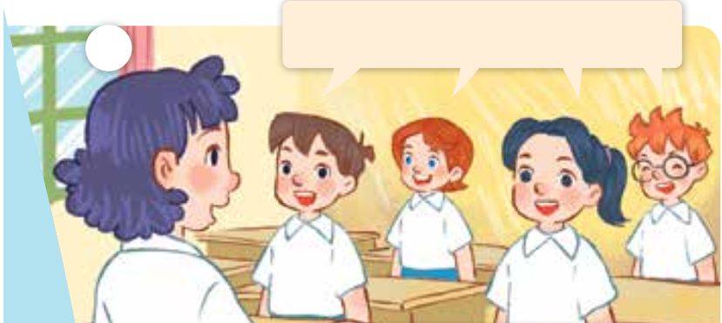
Good morning, Ms Hoa.
Good
morning,
Ms Hoa.
CHECK
Notes:
- Click “CHECK” to check the answer. - Click the wheel on the bottom right to go back to the wheel.

Slide 25
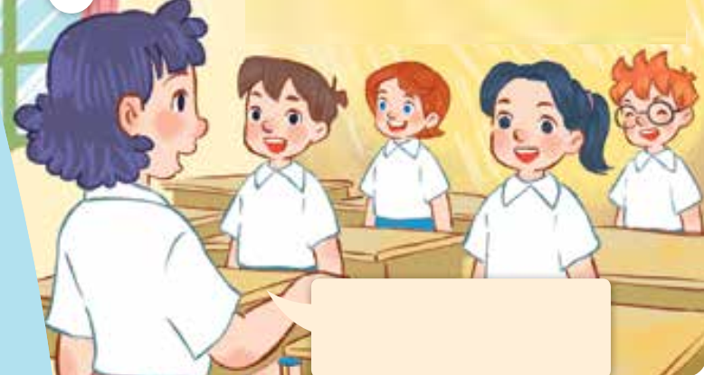
Hello, class.
Sit down, please!
Hello,
class.
Sit down,
please!
CHECK
Notes:
- Click “CHECK” to check the answer. - Click the wheel on the bottom right to go back to the wheel.

Slide 26
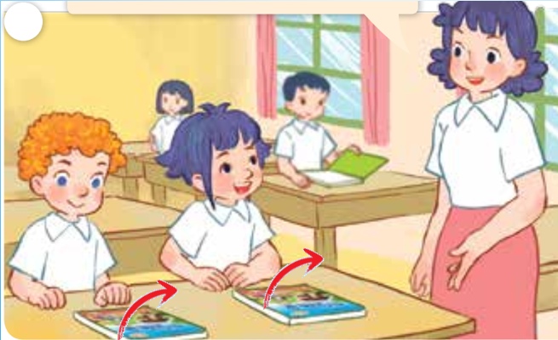
please!
Open your books, please!
Open
your
books,
CHECK
Notes:
- Click “CHECK” to check the answer. - Click the wheel on the bottom right to go back to the wheel.

